Slide 1
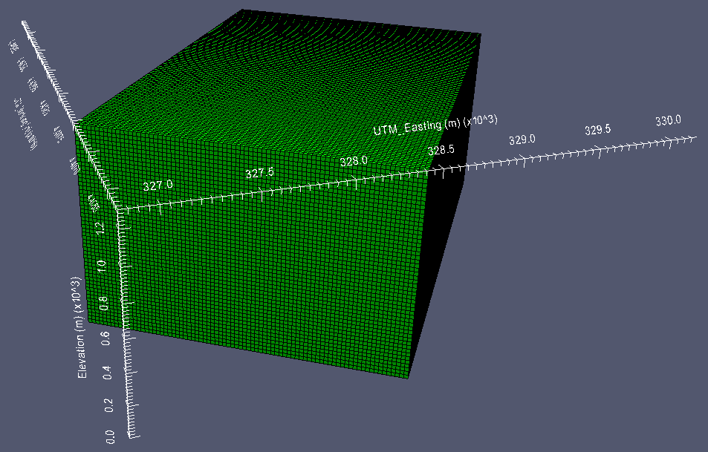
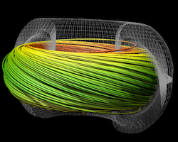
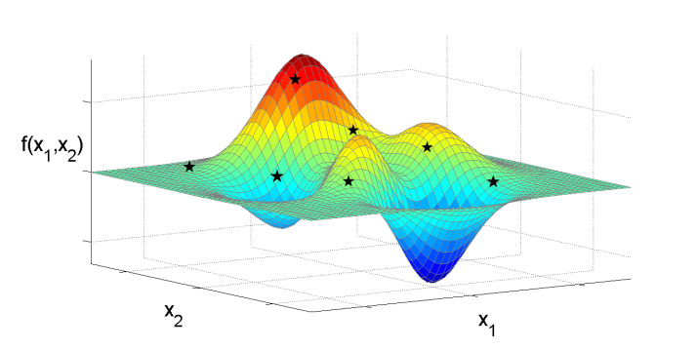
Data ID Service
For DOE
Jannean Elliott
Data Ingest, Media Analyst
DOE OSTI/Acquisition and Information Programs
September 14, 2015
Paraview image from PoroTomo Project, U. of Wisconsin, Geothermal Data Repository
Streamline Integration using MPI-Hybrid Parallelism on a Large Multi-Core Architecture
LBNL Visualization Group >>>
<<< Algorithm Development for Black-Box Global Optimization CCSE, LBNL

Slide 2
Metadata Ingest Tools and Services Announcement Notice 241.6 DOI assignment DOI registration with DataCite
Supporting Data Citation to facilitate:
Long-term discovery and access through stable linkage and identification
Better attribution for researchers and data producers
Better budget and impact tracking for sponsors
Easier reuse and verification of data
New data services of the future

Slide 3
Why Digital Object Identifiers (DOIs)?
Pre-existing global recognition and acceptance in the world of scholarly publications
Standardization through the backing of the International DOI Foundation (IDF) and the National Information Standards Organization (NISO)
OSTI’s prior experience with CrossRef
… and then along came DataCite

Slide 4
www.datacite.org
Three U.S. Members:
California Digital Library
Purdue University
DOE/OSTI
OSTI serves DOE with the Data ID Service, free of charge.
Serves other U.S. Federal Agencies on a cost-recovery basis.
Full membership approved December 2010.
First DOI assigned and minted August 2011.
A global non-profit comprised of local institutions focused on improving the scholarly infrastructure around data
Officially launched December 2009
Executive Board, levels of membership, and Managing Agent TIB.
Only full members may act as
Allocating Agents and provide DOIs
to clients.
Maintains registry of data DOIs and the re3data.org registry of research data repositories.

Slide 5
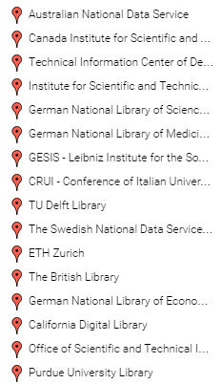
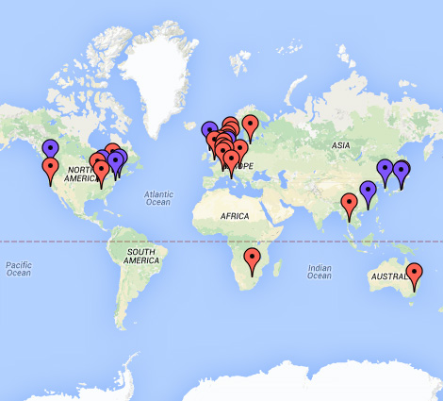
DataCite Members: 2010 - 15 members
in 10 countries; 2014 – 22 members, 9 affiliate members in
19 countries.
Affiliates include: Microsoft Research, IEEE, Beijing Genomics Institute, Harvard, and the Digital Curation Centre

Slide 6
OSTI’s Data ID Service – How Does it Work?
Planning
DOE organization or grantee determines that important datasets exist which need to be announced in DOE's scientific and technical databases and assigned DOIs. DOE O 241.1B instructs that bibliographic information for these datasets be submitted to OSTI.
Metadata is submitted through manual input into the Announcement Notice (AN) 241.6 or via an automated 241.6 web service/API.
Data clients anticipating high volume or high frequency submissions decide to utilize automated submission and contact their STIP Manager and/or OSTI to begin coordination.
Development
Testing
Production
Notes:
Add SciTech Connect logo where I deleted Science Accelerator logo

Slide 7
Automated Submission: The AN 241.6 Web Service
Submitter responsibilities are discussed.
Questions on granularity of DOI assignment are debated
Data client begins development of internal processes that will send metadata to OSTI’s AN 241.6 web service.
Subject expertise and knowledge of how the intended audience will expect to look for and use the data is the key to successfully defining content and dataset boundaries.

Slide 8
Connection and Authentication
Metadata values
XML tags and format
TEST Phase Begins
During planning phase, OSTI obtained a prefix from DataCite that will be unique to this specific data client.
During TEST phase, client is receiving TEST OSTI IDs and DataCite’s TEST DOI prefix.
TEST metadata goes to DataCite’s MDS but not into the Registry.
TEST DOIs will not resolve and they expire/disappear after a time.
A cycle of review and feedback

Slide 9
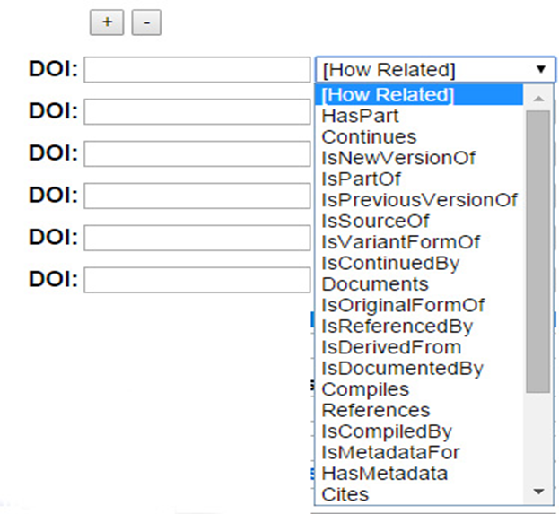
Data ID Service – Development Approach
Customer focused = build as needed
Recent examples:
Reserve model for DOI minting
Intelligent DOI strings with <doi_infix>
(10.19597/myprojectname/1105143)
More protocols supported
Resource Type: Dataset
* Dataset Type:
Animations/Simulations
Figures/Plots
Genome/Genetics Data
Interactive Data Maps
Multimedia
Numeric Data
Software
Specialized Mix
Still Images or Photos

Slide 10
The landing page, which must always be publicly accessible, provides context for the dataset. It may contain one or more of the following:
Information on how a full, formal citation of the data should appear
Access information, including a notice of temporary restriction, if a dataset is not yet ready for public access
Links to software or toolkits needed to open, download, or analyze data
A listing of the individual data files that may be included in the registered dataset (with links to them)
Related resources
Version information
Contact information

Slide 11
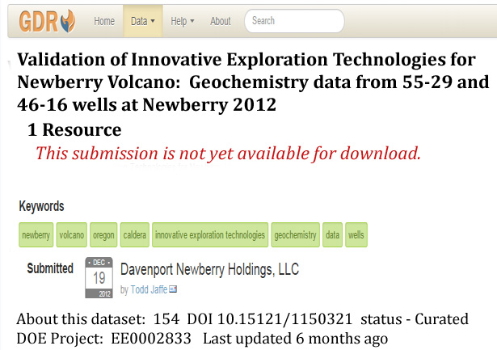
Mandatory when dataset is temporarily restricted >>>>
Or when data requires special software to open.
< Useful when data must be retired
DataCite
Does
Not
Delete !

Slide 12
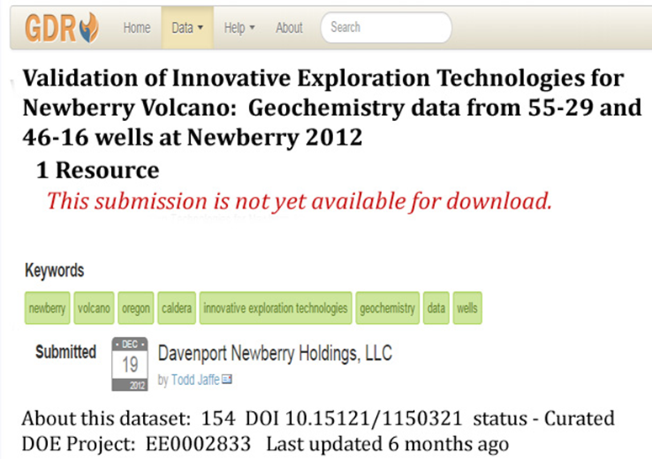
Reserving a DOI - <set_reserved/>
Sometimes a researcher needs to know what the DOI for a dataset will be even before he knows where its landing page will be posted. Reserving a DOI in OSTI’s Data ID Service supports this need.
It assigns a DOI for a particular dataset but ensures that the assigned DOI does not “travel” to DataCite before the researcher is ready for it to do so. If the DOI “travels” before there is a valid URL, DataCite will not mint. The DOI would not be registered and cannot function as a live link.
Note: This GDR dataset was a straightforward, normal submission because the landing page, with good information, was publicly available at the time of submission. The DOI did not have to be reserved.

Slide 13
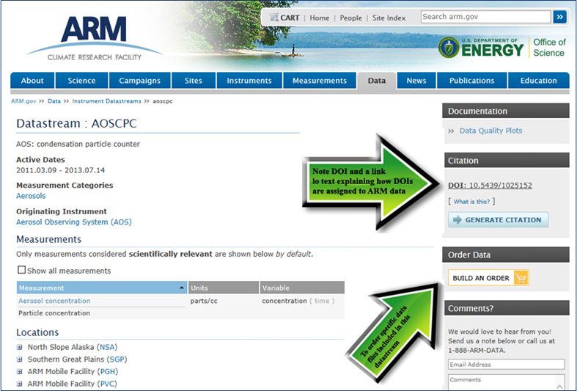

Slide 15
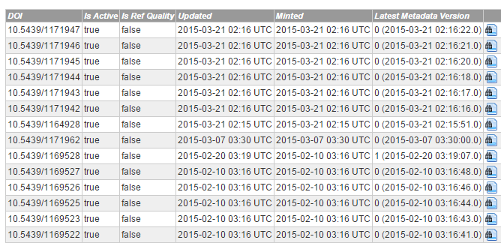
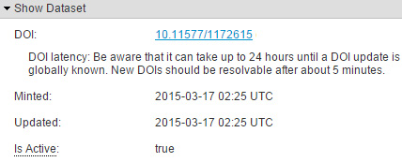
When OSTI and the client agree they are mutually ready, OSTI sets up the 241.6 web service account in production E-Link.
OSTI’s server service provides immediate response to client after each submission and E-Link follows with an automated email.
Overnight the metadata record is released in E-Link and travels to the DataCite Registry. New DOIs “mint” immediately. Updates may not go “live” for several hours.

Slide 16
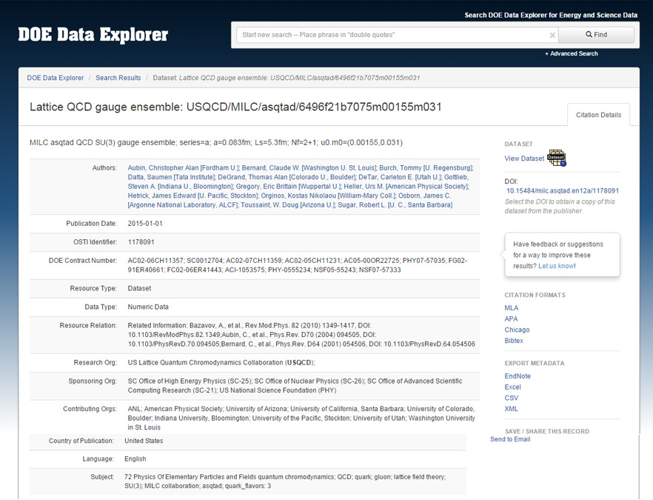

Slide 17
DOE Data Clients
Climate Change Science Institute (Oak Ridge National Laboratory)
Coherent X-Ray Imaging Data Bank (Lawrence Berkeley National Laboratory)
DOE Geothermal Data Repository (OpenEI)
The Materials Project (Lawrence Berkeley National Laboratory)
Measurement and Instrumentation Data Center (National Renewable Energy Laboratory)
Microscopy Data Portal, PREMIER Network (Pacific Northwest National Laboratory)
Next Generation Ecosystem Experiments – Arctic (Oak Ridge National Laboratory)
Oak Ridge Leadership Computing Facility (Oak Ridge National Laboratory)
Total Carbon Column Observation Network (TCCON) Data Archive, Carbon Dioxide Information Analysis Center (Oak Ridge National Laboratory)

Slide 18
DOE Data Clients
DOE data clients may be data centers or scientific user facilities, large projects or collaborations. They may also be individuals with only one or two datasets to submit in support of a publication.
OSTI is actively supporting the Office of Science as it leads Departmental implementation of the Digital Data Management component of the Public Access Plan.
DOI prefix = 10.7799: NREL
DOI prefix = 10.14460: PNNL
DOI prefix = 10.17021: LANL
DOI prefix = 10.17022: SLAC
DOI prefix = 10.17023: BNL
DOI prefix = 10.17024: ORNL
DOI prefix = 10.17038: ANL
DOI prefix = 10.17187: TJNAF
DOI prefix = 10.17186: NETL
DOI prefix = 10.17190: PPPL
And just to mention our other data clients:
U.S. Treasury (Office of Financial Services)
U.S. Treasury (Office of Financial Research)
U.S. Department of Agriculture (Agriculture Research Service)
National Institute of Mental Health (National Autism Research Database)
National Institutes of Health Library (Intramural)
Food and Drug Administration (in the planning stage)
Federal Reserve Board (in the planning stage)

Slide 19
Your Data’s Visibility
In addition to receiving DOIs, submitted datasets are searchable in DOE databases such as SciTech Connect and the DOE Data Explorer. They are also indexed by commercial search engines (e.g., Google) and appear in federated search portals, such as Science.gov (interagency resource) and WorldWideScience.org (international resource). They are beginning to appear in the Thomson Reuters product, Data Citation Index.
Final Words:
We want ORCIDs!
2016 Conference for DataCite, North America
Ongoing thrust – linkage of datasets and publications

