Slide 1
GUI Current Status and Outlook
Stefan Schoenawa, Volkswagen AG

Slide 2
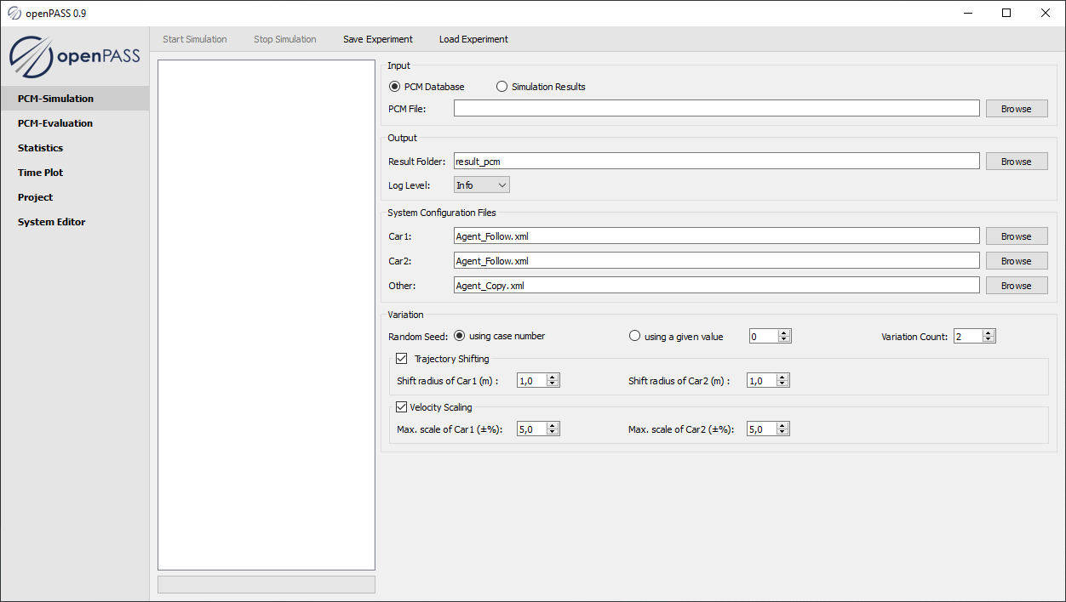
Current Status of GUI
Stuck in an old version ~0.8-0.9
PCM Plugin with V4 support (Simulation + Evaluation)
Project Plugin
System Editor
Scenario based Simulation Plugin deactivated
No parameterization of stochastic parameter possible
No CI/Jenkins integration

Slide 3
Next work
PCM Plugin:
Adapt the generation of the vehicle catalog (version of the scheme)
Support of PCM v.5.0
Import of PCM as SQLite
Scenario Based Simulation Plugin:
Reintegrate this Plugin and make it useable
Configurations shall be save- and loadable
cmake instead of qmake
System Editor Plugin:
Stochastic parameter should be choosable (refinement meeting with interested partners desired)
Strings as parameters
Project Plugin:
Make LogLevel choosable
General:
Make GUI CI/Jenkins capable

Slide 4
Outlook, Questions
Onboarding of new GUI developer from Hexad nearly completed
Contributions of bug fixes and smaller features in near future
How will be the process?
Issue (e.g. bug) → assignee → merge request → CI → review → merge
Will Hexad's colleagues be able to make reviews, or will they have to be committers to do so?
yes, but cannot assign (instead: report to working group)
Integration of GUI-support of simulation core functionalities

Slide 5
Discussion
Which features shall the GUI support (or which not)?
Discussion:
PCM Version 5.0 + sqlite (maybe support of objects – s. feature branch)
PCM-Converter seperate from GUI? No, because GUI only creates configs for openPASS
Further refinement meeting needed
Maybe: Integration of OSCE (openSCENARIO Editor) from CARIAD
GUI has to guide the user to create all needed xml/config-files (create default ones)

