Slide 1
Eclipse IoT monthly report
September 2017

Slide 2
Monthly projects development activity
SEP '17 | (color indicates variation compared to previous month)
 | Opened bugs | Closed bugs | Code authors | Commits | Posted messages | Senders
4diac | 17 | 18 | 6 | 45 | 45 | 9
californium | 18 | 14 | 6 | 74 | 16 | 6
concierge | 0 | 0 | 0 | 0 | 0 | 0
ditto | 0 | 0 | 0 | 0 | 0 | 0
eclipsescada | 4 | 0 | 0 | 0 | 0 | 0
edje | 0 | 0 | 0 | 0 | 0 | 0
hawkbit | 8 | 4 | 3 | 8 | 0 | 0
hono | 32 | 28 | 10 | 72 | 69 | 8
kapua | 50 | 174 | 9 | 479 | 19 | 6
krikkit | 0 | 0 | 0 | 0 | 0 | 0
kura | 64 | 72 | 8 | 98 | 17 | 3
leshan | 10 | 10 | 5 | 50 | 6 | 8
milo | 6 | 4 | 3 | 98 | 4 | 3
mosquitto | 42 | 10 | 0 | 0 | 19 | 9
om2m | 125 | 124 | 2 | 124 | 0 | 0
paho | 130 | 62 | 15 | 59 | 1 | 1
paho.incubator | 0 | 0 | 0 | 0 | 0 | 0
ponte | 2 | 0 | 0 | 0 | 0 | 0
risev2g | 0 | 0 | 0 | 0 | 0 | 0
smarthome | 120 | 134 | 15 | 121 | 0 | 0
tinydtls | 0 | 0 | 0 | 0 | 2 | 1
unide | 0 | 0 | 1 | 4 | 0 | 0
vorto | 10 | 20 | 5 | 59 | 0 | 0
wakaama | 6 | 4 | 2 | 2 | 2 | 2
whiskers | 0 | 0 | 0 | 0 | 0 | 0
ALL PROJECTS | 644 | 678 | 90 | 1293 | 200 | 56

Slide 3
Yearly projects development activity
OCT '16 - SEP '17 | (color indicates variation compared to previous period)
 | Opened bugs | Closed bugs | Code authors | Commits | Posted messages | Senders
4diac | 209 | 209 | 9 | 367 | 57 | 9
californium | 123 | 107 | 24 | 832 | 511 | 35
concierge | 24 | 3 | 5 | 15 | 5 | 3
ditto | 0 | 0 | 1 | 1 | 0 | 0
eclipsescada | 8 | 4 | 3 | 273 | 0 | 0
edje | 1 | 1 | 2 | 66 | 8 | 5
hawkbit | 48 | 47 | 13 | 283 | 14 | 9
hono | 128 | 112 | 18 | 837 | 361 | 31
kapua | 357 | 236 | 18 | 4303 | 466 | 21
krikkit | 0 | 0 | 0 | 0 | 1 | 1
kura | 510 | 493 | 21 | 1456 | 340 | 43
leshan | 78 | 64 | 18 | 396 | 332 | 74
milo | 40 | 41 | 6 | 295 | 113 | 20
mosquitto | 204 | 119 | 30 | 158 | 306 | 127
om2m | 221 | 252 | 5 | 188 | 13 | 12
paho | 628 | 468 | 75 | 976 | 399 | 217
paho.incubator | 0 | 0 | 0 | 0 | 0 | 0
ponte | 22 | 5 | 2 | 3 | 5 | 5
risev2g | 3 | 4 | 1 | 14 | 0 | 0
smarthome | 773 | 688 | 87 | 1211 | 44 | 9
tinydtls | 21 | 21 | 3 | 37 | 93 | 15
unide | 10 | 4 | 3 | 27 | 7 | 3
vorto | 198 | 194 | 8 | 439 | 11 | 9
wakaama | 57 | 49 | 13 | 136 | 107 | 60
whiskers | 2 | 0 | 2 | 9 | 10 | 8
ALL PROJECTS | 3665 | 3121 | 294 | 12322 | 3203 | 398

Slide 4
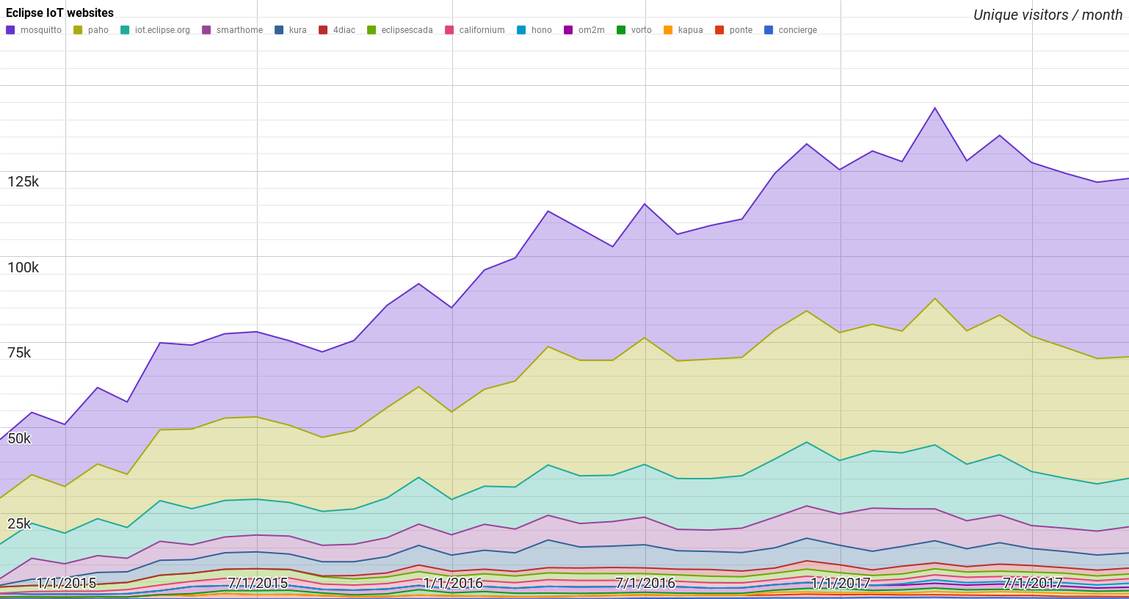
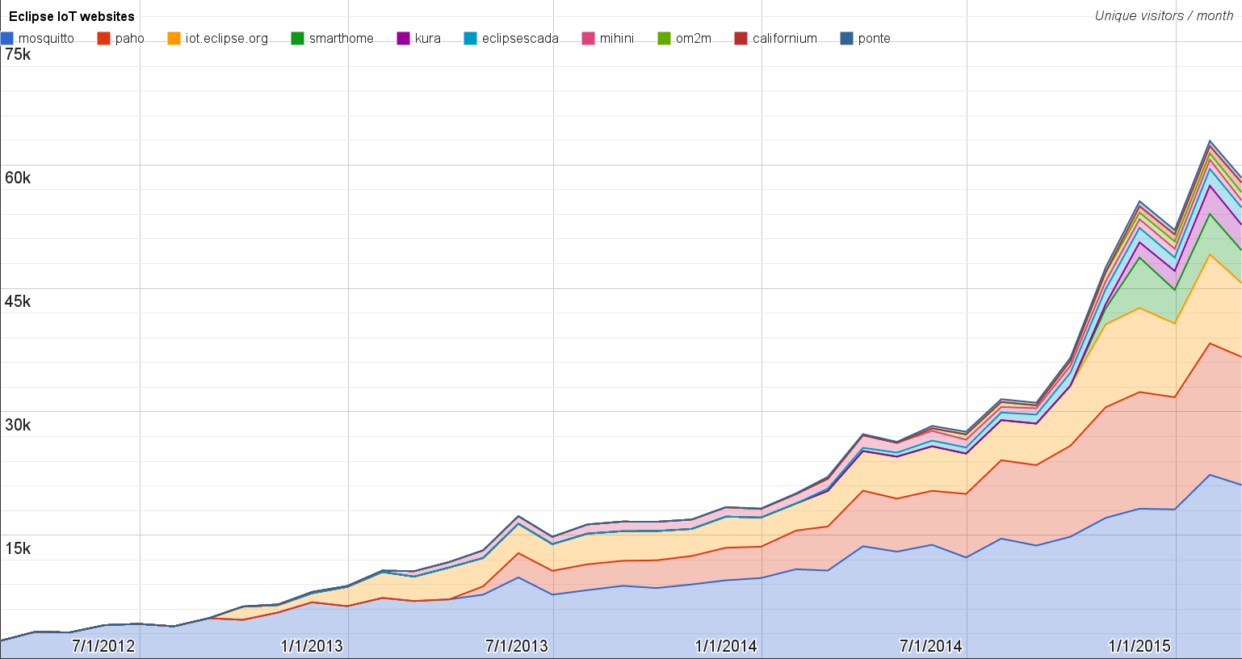
Websites
https://docs.google.com/spreadsheets/d/1MT8vUectDG7qnt83LBts-B7oECMsICXyB4Tn4Kxl64U/pubchart?oid=1293913369&format=image
Number of unique visitors this month | 122.8K
Month-over-month variation | +1%
Project with the highest growth this month | Eclipse hono (+28%)
Year-over-year variation | +26% (1.22K → 1.54M visitors)

Slide 5
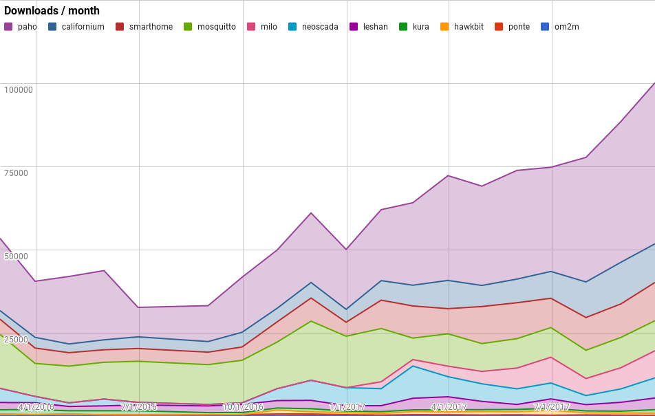
Downloads
https://docs.google.com/spreadsheets/d/1MT8vUectDG7qnt83LBts-B7oECMsICXyB4Tn4Kxl64U/pubchart?oid=1715994217&format=image
Downloads this month:
paho | 48402
californium | 11597
smarthome | 11503
mosquitto | 9026
milo | 8164
neoscada | 6037
leshan | 3494
kura | 1077
hawkbit | 614
ponte | 120
om2m | 113
Grand Total | 100147

Slide 6
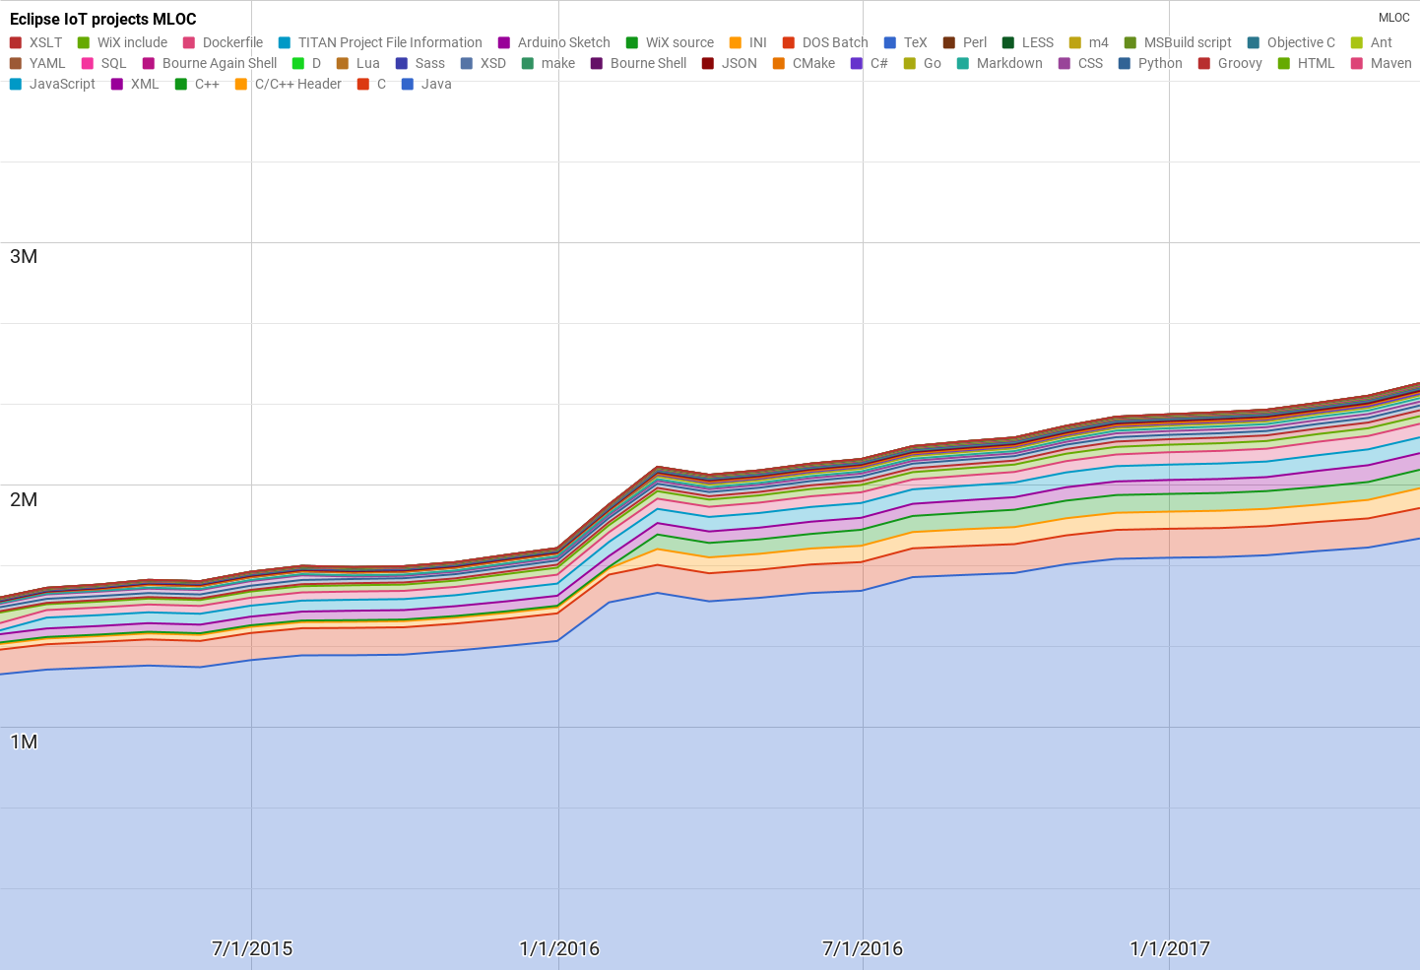
Lines of code (as of May-31, 2017)
https://docs.google.com/spreadsheets/d/1MT8vUectDG7qnt83LBts-B7oECMsICXyB4Tn4Kxl64U/pubchart?oid=1652481431&format=image

Slide 7
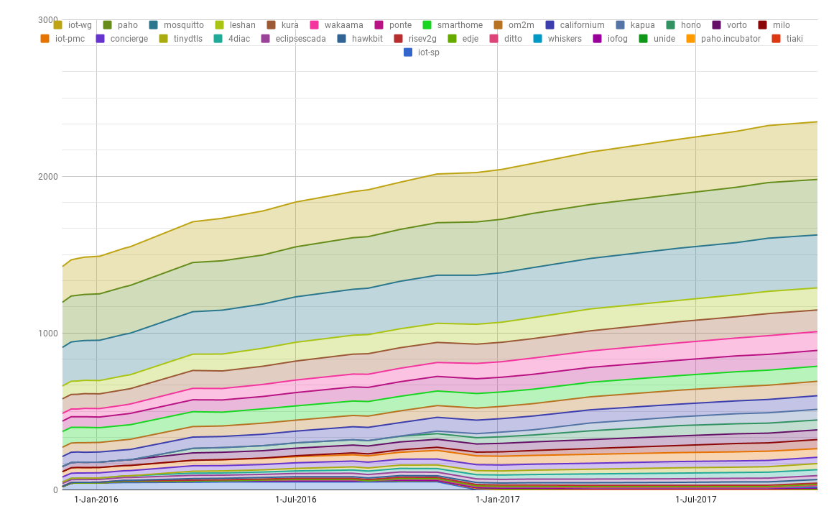
Mailing list subscriptions
https://docs.google.com/spreadsheets/d/1MT8vUectDG7qnt83LBts-B7oECMsICXyB4Tn4Kxl64U/pubchart?oid=1893372427&format=image

