Slide 1
Eclipse IoT monthly report
November 2016

Slide 2
Monthly projects development activity
NOV '16 | (color indicates variation compared to previous month)
 | Opened bugs | Closed bugs | Code authors | Commits | Posted messages | Senders
4diac | 2 | 1 | 0 | 0 | 0 | 0
californium | 24 | 24 | 2 | 10 | 2 | 1
concierge | 1 | 1 | 0 | 0 | 1 | 1
eclipsescada | 0 | 0 | 0 | 0 | 0 | 0
edje | 1 | 0 | 0 | 0 | 0 | 0
hawkbit | 2 | 6 | 5 | 8 | 0 | 0
hono | 0 | 3 | 1 | 4 | 0 | 0
krikkit | 0 | 0 | 0 | 0 | 0 | 0
kura | 86 | 52 | 7 | 43 | 2 | 1
leshan | 7 | 2 | 3 | 8 | 1 | 1
milo | 10 | 11 | 3 | 14 | 0 | 0
mosquitto | 18 | 4 | 0 | 0 | 0 | 0
om2m | 0 | 0 | 0 | 0 | 0 | 0
paho | 46 | 25 | 2 | 5 | 2 | 2
paho.incubator | 0 | 0 | 0 | 0 | 0 | 0
ponte | 2 | 0 | 0 | 0 | 0 | 0
risev2g | 2 | 0 | 1 | 2 | 0 | 0
smarthome | 79 | 72 | 10 | 21 | 0 | 0
tinydtls | 0 | 0 | 0 | 0 | 1 | 1
vorto | 17 | 17 | 2 | 5 | 0 | 0
wakaama | 2 | 0 | 0 | 0 | 0 | 0
whiskers | 0 | 0 | 0 | 0 | 0 | 0
ALL PROJECTS | 299 | 218 | 36 | 120 | 9 | 7

Slide 3
Yearly projects development activity
DEC '15 - NOV '16 | (color indicates variation compared to previous period)
 | Opened bugs | Closed bugs | Code authors | Commits | Posted messages | Senders
4diac | 91 | 156 | 12 | 176 | 12 | 2
californium | 93 | 87 | 22 | 309 | 224 | 12
concierge | 25 | 27 | 4 | 24 | 20 | 7
eclipsescada | 2 | 19 | 3 | 352 | 3 | 1
edje | 1 | 0 | 2 | 2 | 1 | 1
hawkbit | 31 | 17 | 25 | 1396 | 0 | 0
hono | 56 | 45 | 7 | 354 | 125 | 6
krikkit | 0 | 1 | 1 | 1 | 0 | 0
kura | 450 | 263 | 21 | 1524 | 105 | 19
leshan | 73 | 62 | 20 | 413 | 107 | 18
milo | 47 | 42 | 9 | 140 | 13 | 6
mosquitto | 287 | 181 | 19 | 214 | 256 | 38
om2m | 1 | 1 | 6 | 65 | 21 | 4
paho | 819 | 610 | 55 | 418 | 333 | 44
paho.incubator | 0 | 0 | 0 | 0 | 0 | 0
ponte | 2 | 0 | 3 | 7 | 0 | 0
risev2g | 4 | 1 | 1 | 17 | 1 | 1
smarthome | 847 | 726 | 88 | 1035 | 51 | 6
tinydtls | 0 | 2 | 2 | 14 | 25 | 3
vorto | 271 | 159 | 20 | 412 | 0 | 1
wakaama | 64 | 54 | 14 | 197 | 60 | 12
whiskers | 2 | 0 | 3 | 31 | 1 | 1
ALL PROJECTS | 3166 | 2453 | 337 | 7101 | 1358 | 44

Slide 4
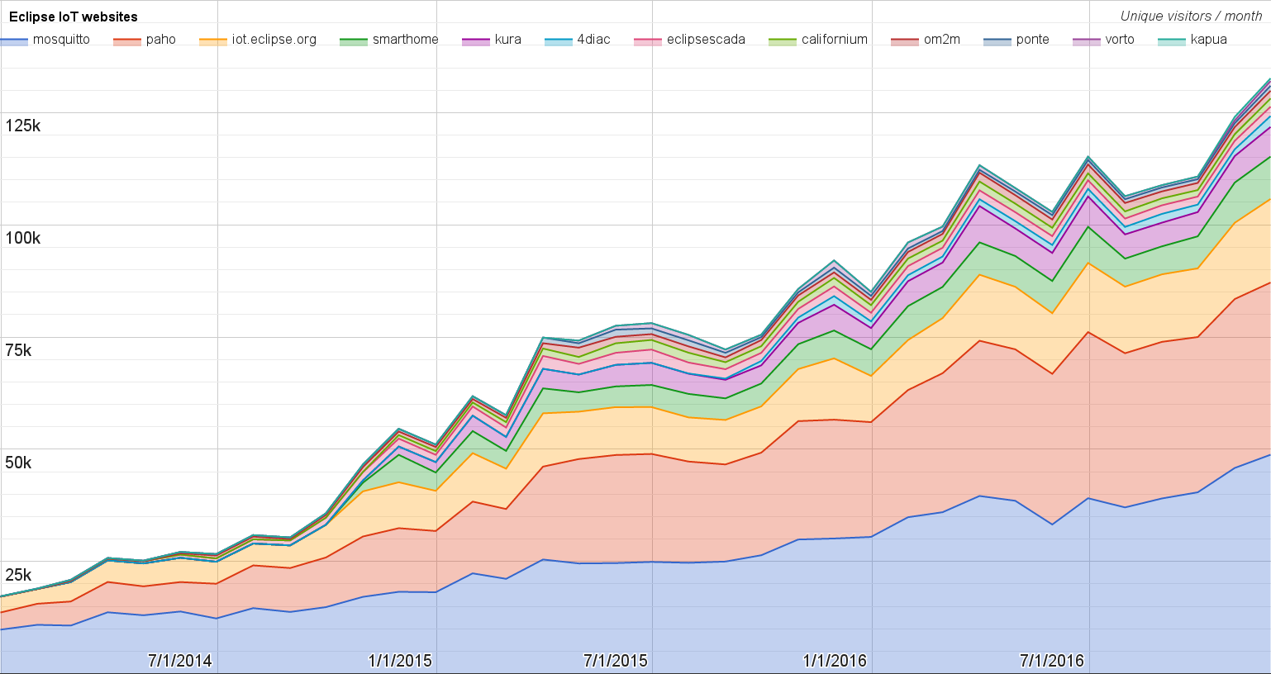
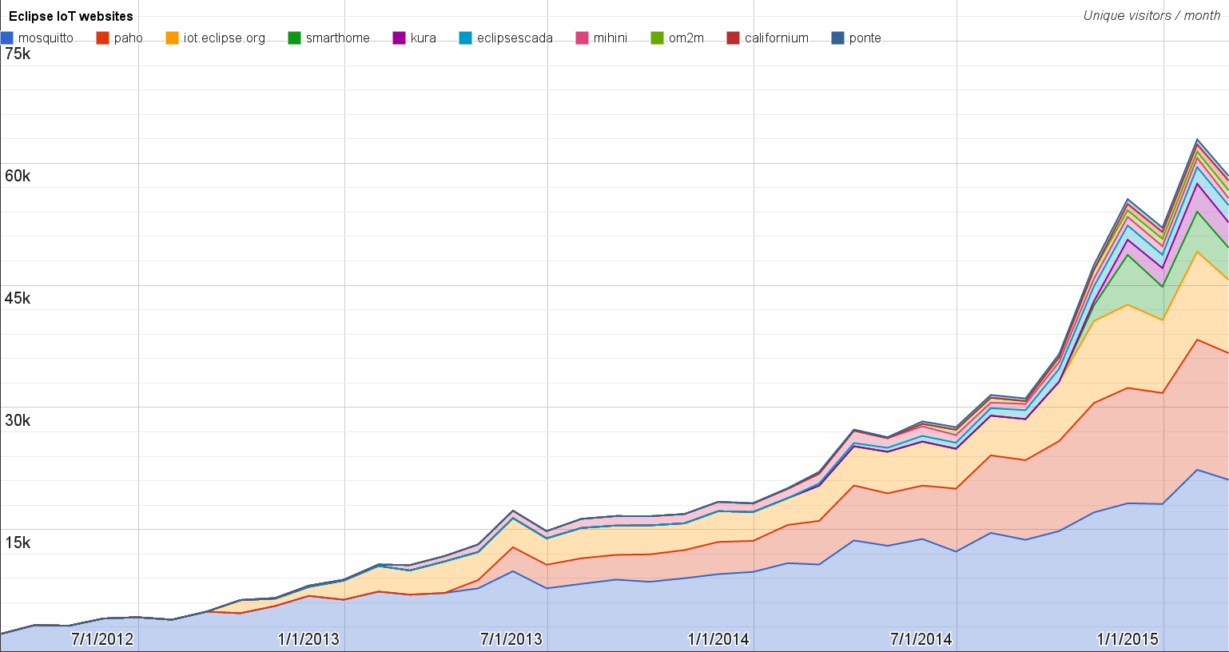
Websites
https://docs.google.com/spreadsheets/d/1MT8vUectDG7qnt83LBts-B7oECMsICXyB4Tn4Kxl64U/pubchart?oid=1293913369&format=image
Number of unique visitors this month | 133K
Month-over-month variation | +7%
Project with the highest growth this month | Eclipse Vorto (+75%)
Year-over-year variation | +48% (870K → 1.30M visitors)

Slide 5
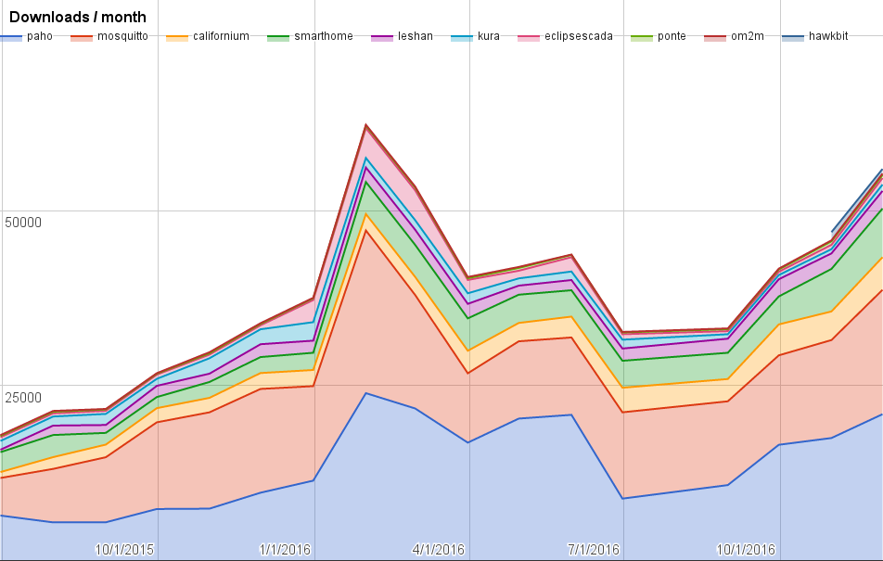
Downloads
https://docs.google.com/spreadsheets/d/1MT8vUectDG7qnt83LBts-B7oECMsICXyB4Tn4Kxl64U/pubchart?oid=1715994217&format=image
Downloads this month:
paho | 20902
mosquitto | 17767
smarthome | 6955
californium | 4658
leshan | 2518
eclipsescada | 934
kura | 904
hawkbit | 662
ponte | 436
om2m | 197

Slide 6
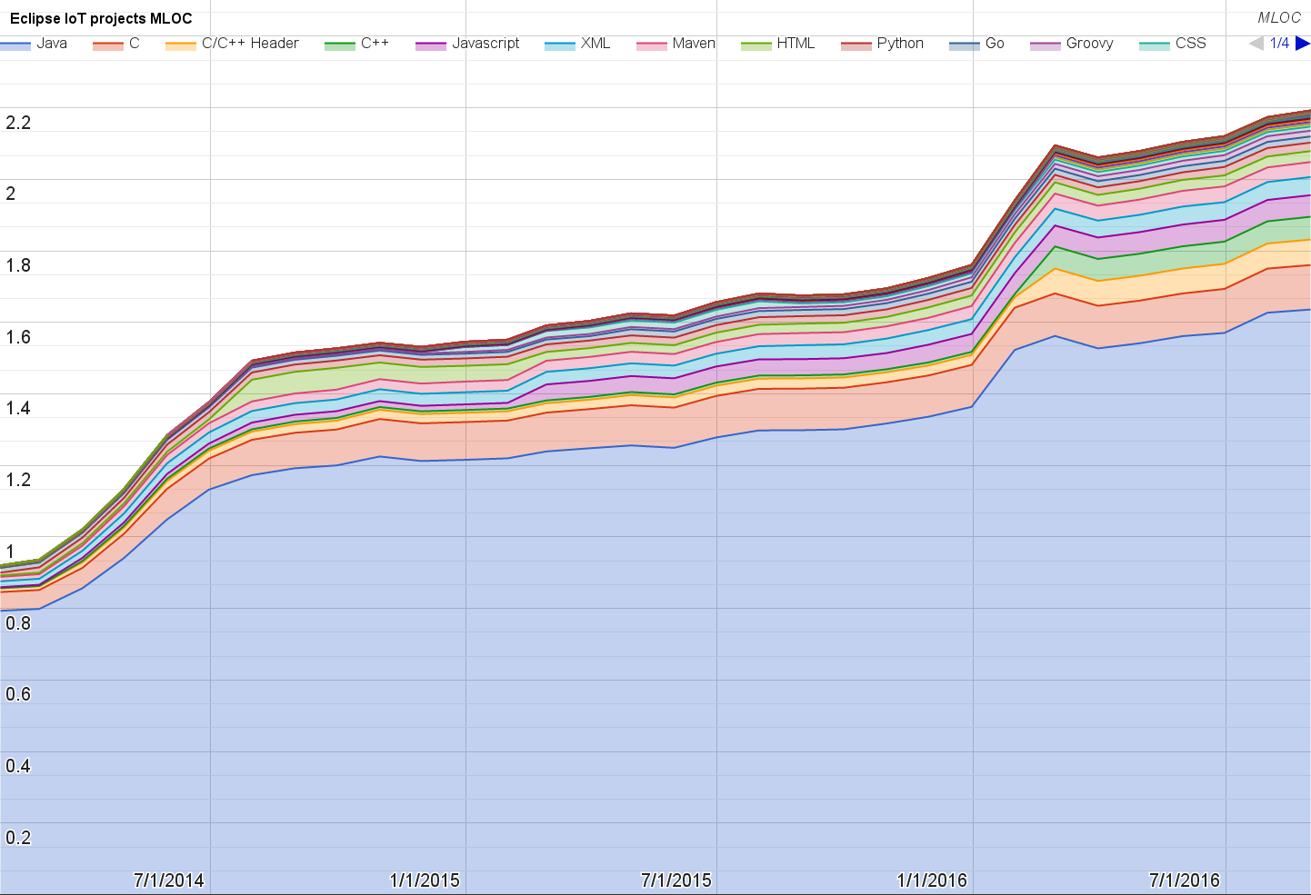
Lines of code (as of Aug-31, 2016)
https://docs.google.com/spreadsheets/d/1MT8vUectDG7qnt83LBts-B7oECMsICXyB4Tn4Kxl64U/pubchart?oid=1652481431&format=image

Slide 7
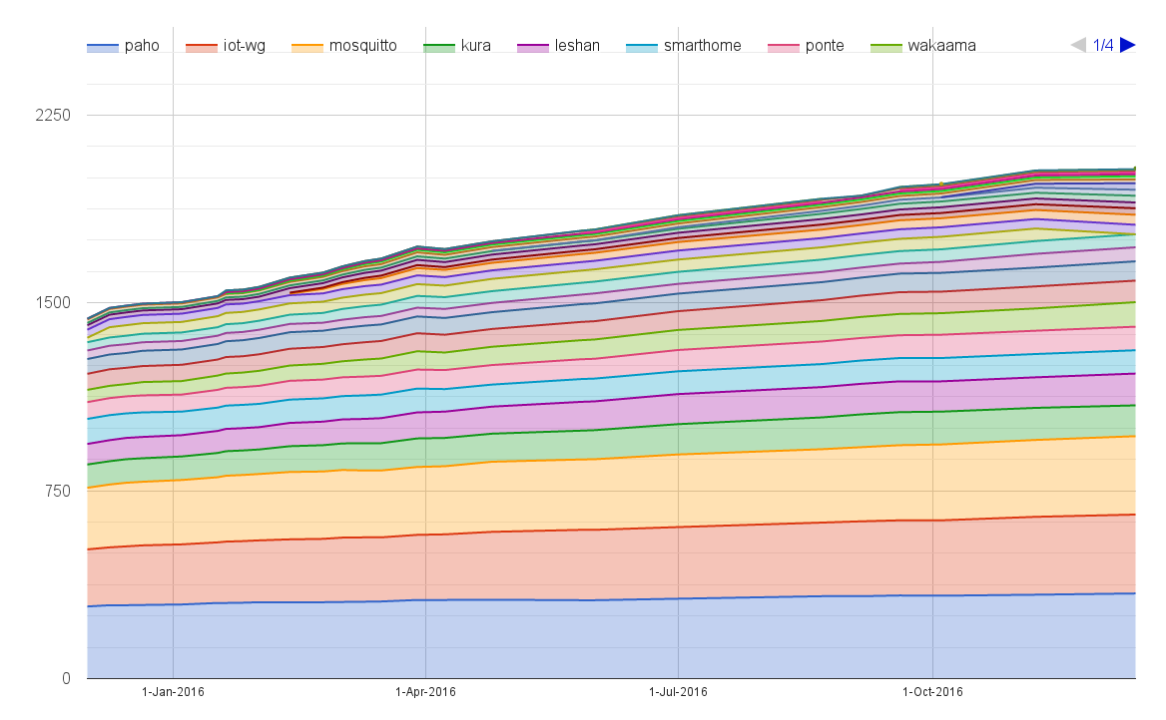
Mailing list subscriptions
https://docs.google.com/spreadsheets/d/1MT8vUectDG7qnt83LBts-B7oECMsICXyB4Tn4Kxl64U/pubchart?oid=1893372427&format=image

Slide 8
Sandbox servers (MQTT, CoAP, LwM2M)
http://vs0.inf.ethz.ch/logs/origin-trace/
MQTT (Mosquitto)
916 active clients (+12% monthly)
CoAP
131 unique IP addresses (+211% monthly)
LWM2M
See Bug 467101

