Slide 1
Eclipse IoT monthly report
May 2016

Slide 2
Monthly projects development activity
MAY '16 | (color indicates variation compared to previous month)
 | Opened bugs | Closed bugs | Code authors | Commits | Posted messages | Senders
4diac | 11 | 11 | 3 | 8 | 0 | 0
californium | 0 | 0 | 2 | 4 | 7 | 3
concierge | 2 | 0 | 0 | 0 | 0 | 0
eclipsescada | 0 | 0 | 1 | 12 | 0 | 0
hawkbit | 0 | 0 | 7 | 110 | 0 | 0
hono | 0 | 0 | 4 | 43 | 5 | 2
krikkit | 0 | 0 | 0 | 0 | 0 | 0
kura | 0 | 0 | 8 | 79 | 6 | 2
leshan | 0 | 0 | 3 | 4 | 18 | 5
mosquitto | 0 | 0 | 3 | 12 | 12 | 4
om2m | 0 | 0 | 2 | 3 | 0 | 0
paho | 0 | 0 | 7 | 28 | 27 | 7
paho.incubator | 0 | 0 | 0 | 0 | 0 | 0
ponte | 0 | 0 | 0 | 0 | 0 | 0
risev2g | 0 | 0 | 0 | 0 | 0 | 0
smarthome | 0 | 0 | 38 | 160 | 4 | 2
tiaki | 0 | 0 | 0 | 0 | 0 | 0
vorto | 0 | 0 | 10 | 80 | 0 | 0
wakaama | 0 | 0 | 3 | 4 | 5 | 3
ALL PROJECTS | 13 | 11 | 91 | 547 | 84 | 28

Slide 3
Github monthly activity
Pull requests
Issues
 | April 2016 | May 2016
iot.californium | 12 | 3
iot.hawkbit | 44 | 29
iot.hono | 1 | 0
iot.kura | 6 | 22
iot.leshan | 16 | 9
iot.milo |  | 1
iot.mosquitto | 7 | 14
iot.paho | 48 | 44
iot.ponte | 1 | 0
iot.risev2g | 0 | 0
iot.smarthome | 125 | 405
iot.tiaki | 0 | 0
iot.vorto | 8 | 27
iot.wakaama | 11 | 7
iot.whiskers |  | 0
Grand Total | 279 | 561
 | April 2016 | May 2016
iot.californium | 17 | 11
iot.hawkbit | 4 | 15
iot.hono | 20 | 19
iot.kura | 70 | 111
iot.leshan | 7 | 4
iot.milo |  | 2
iot.mosquitto | 6 | 26
iot.paho | 44 | 125
iot.ponte | 0 | 0
iot.risev2g | 0 | 0
iot.smarthome | 97 | 99
iot.tiaki | 0 | 0
iot.vorto | 29 | 37
iot.wakaama | 6 | 7
iot.whiskers |  | 0
Grand Total | 300 | 456

Slide 4
Yearly projects development activity
JUN '15 - MAY '16 | (color indicates variation compared to previous period)
 | Opened bugs | Closed bugs | Code authors | Commits | Posted messages | Senders
4diac | 53 | 63 | 5 | 53 | 18 | 2
californium | 13 | 17 | 22 | 538 | 400 | 19
concierge | 13 | 3 | 4 | 131 | 15 | 5
eclipsescada | 15 | 33 | 2 | 420 | 4 | 2
hawkbit | 0 | 0 | 16 | 695 | 1 | 1
hono | 0 | 0 | 5 | 128 | 85 | 6
krikkit | 0 | 0 | 1 | 1 | 0 | 0
kura | 7 | 1 | 15 | 966 | 97 | 18
leshan | 1 | 5 | 19 | 344 | 210 | 28
mosquitto | 28 | 41 | 13 | 178 | 344 | 65
om2m | 1 | 1 | 6 | 30 | 25 | 4
paho | 56 | 31 | 35 | 306 | 493 | 70
paho.incubator | 0 | 0 | 0 | 0 | 0 | 0
ponte | 1 | 0 | 3 | 20 | 0 | 0
risev2g | 0 | 0 | 2 | 48 | 4 | 2
smarthome | 72 | 186 | 74 | 1630 | 106 | 7
tiaki | 0 | 0 | 3 | 24 | 2 | 2
vorto | 76 | 24 | 18 | 1112 | 2 | 2
wakaama | 0 | 0 | 11 | 225 | 120 | 18
ALL PROJECTS | 336 | 405 | 249 | 6849 | 1926 | 249

Slide 5
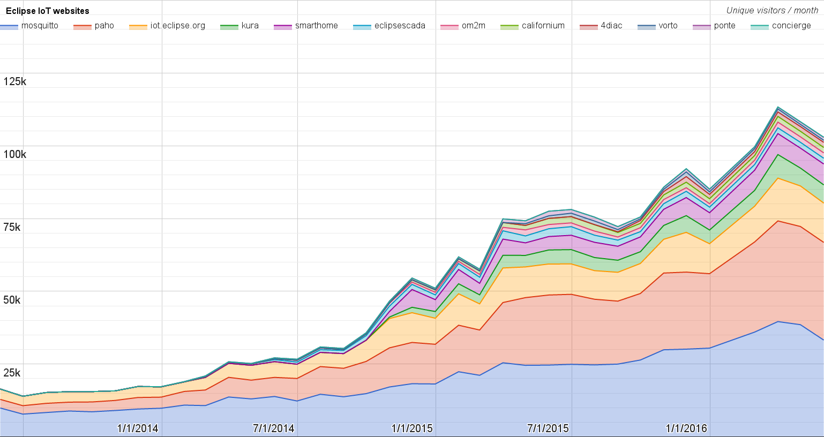
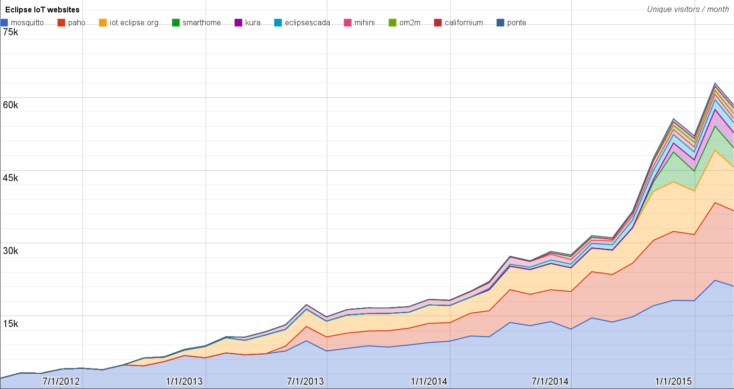
Websites
https://docs.google.com/spreadsheets/d/1MT8vUectDG7qnt83LBts-B7oECMsICXyB4Tn4Kxl64U/pubchart?oid=1293913369&format=image
Number of unique visitors this month | 103K
Month-over-month variation | - 4.9%
Project with the highest growth this month | Eclipse Ponte (+18%)
Year-over-year variation | +83% (582K → 1.07M unique visitors)

Slide 6
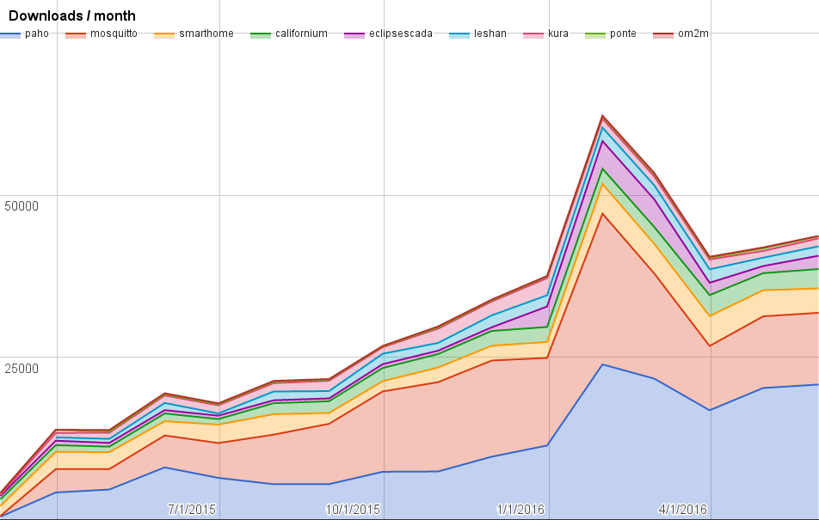
Downloads
https://docs.google.com/spreadsheets/d/1MT8vUectDG7qnt83LBts-B7oECMsICXyB4Tn4Kxl64U/pubchart?oid=1715994217&format=image
Downloads this month:
paho | 20811
mosquitto | 11051
smarthome | 3765
californium | 2980
eclipsescada | 2047
leshan | 1456
kura | 1222
ponte | 323
om2m | 53

Slide 7
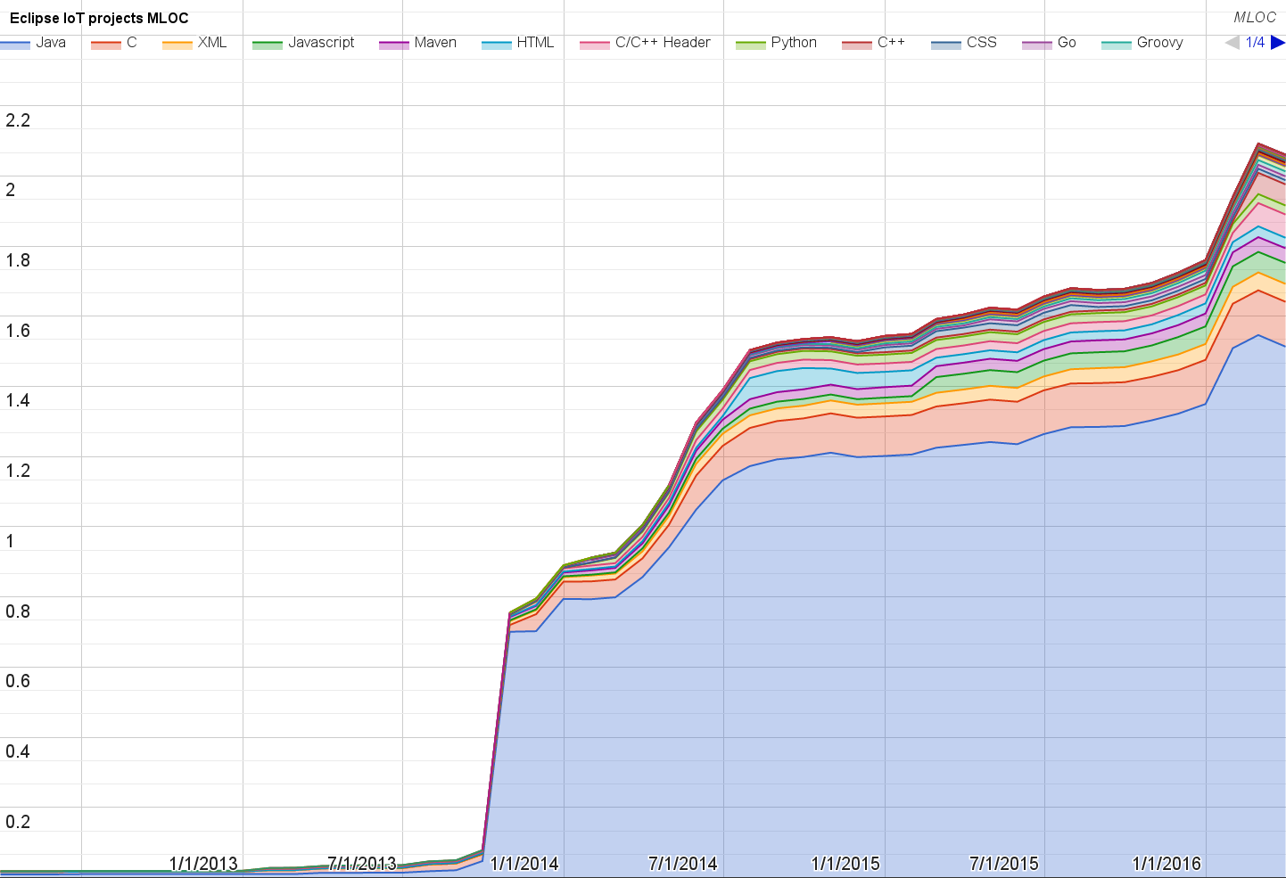
Lines of code (as of Mar-31, 2016)
https://docs.google.com/spreadsheets/d/1MT8vUectDG7qnt83LBts-B7oECMsICXyB4Tn4Kxl64U/pubchart?oid=1652481431&format=image

Slide 8
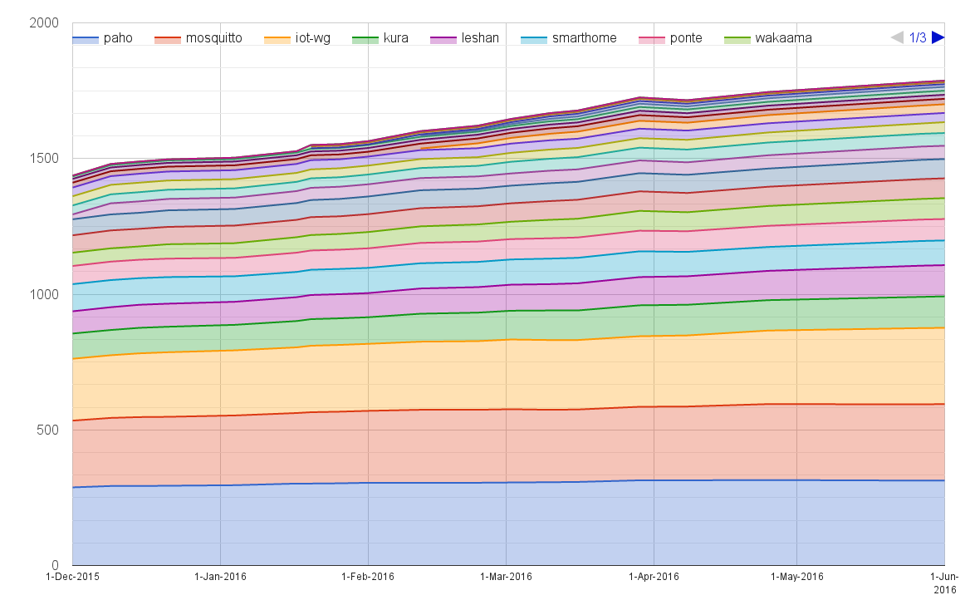
Mailing list subscriptions
https://docs.google.com/spreadsheets/d/1MT8vUectDG7qnt83LBts-B7oECMsICXyB4Tn4Kxl64U/pubchart?oid=1893372427&format=image

Slide 9
Sandbox servers (MQTT, CoAP, LwM2M)
MQTT (Mosquitto)
489 active clients (-3% monthly)
CoAP
198 unique IP addresses
LWM2M
See Bug 467101

