Slide 1
Eclipse IoT monthly report
June 2016

Slide 2
Monthly projects development activity
JUN '16 | (color indicates variation compared to previous month)
 | Opened bugs | Closed bugs | Code authors | Commits | Posted messages | Senders
4diac | 8 | 16 | 5 | 15 | 0 | 0
californium | 8 | 9 | 4 | 14 | 20 | 3
concierge | 0 | 0 | 0 | 0 | 4 | 3
eclipsescada | 0 | 0 | 2 | 10 | 0 | 0
edje | 0 | 0 | 0 | 0 | 0 | 0
hawkbit | 2 | 0 | 9 | 146 | 0 | 0
hono | 0 | 0 | 3 | 39 | 24 | 3
krikkit | 0 | 0 | 0 | 0 | 0 | 0
kura | 30 | 18 | 9 | 51 | 7 | 5
leshan | 9 | 11 | 5 | 28 | 4 | 2
milo | 0 | 0 | 1 | 11 | 1 | 1
mosquitto | 14 | 13 | 5 | 43 | 40 | 8
om2m | 0 | 1 | 1 | 1 | 0 | 0
paho | 35 | 39 | 9 | 62 | 21 | 8
paho.incubator | 0 | 0 | 0 | 0 | 0 | 0
ponte | 0 | 0 | 0 | 0 | 0 | 0
risev2g | 0 | 0 | 0 | 0 | 0 | 0
smarthome | 90 | 68 | 38 | 183 | 0 | 0
tinydtls | 0 | 0 | 0 | 0 | 0 | 0
vorto | 76 | 45 | 16 | 151 | 0 | 0
wakaama | 16 | 10 | 8 | 29 | 6 | 4
whiskers | 0 | 0 | 0 | 0 | 0 | 0
ALL PROJECTS | 288 | 230 | 115 | 783 | 127 | 37

Slide 3
Yearly projects development activity
JUL '15 - JUN '16 | (color indicates variation compared to previous period)
 | Opened bugs | Closed bugs | Code authors | Commits | Posted messages | Senders
4diac | 61 | 82 | 7 | 72 | 18 | 2
californium | 47 | 51 | 21 | 540 | 399 | 19
concierge | 12 | 3 | 5 | 132 | 19 | 6
eclipsescada | 15 | 33 | 2 | 421 | 4 | 2
edje | 0 | 0 | 1 | 1 | 1 | 1
hawkbit | 21 | 5 | 20 | 912 | 1 | 1
hono | 32 | 25 | 5 | 169 | 109 | 6
krikkit | 0 | 0 | 1 | 1 | 0 | 0
kura | 171 | 64 | 16 | 943 | 85 | 19
leshan | 31 | 42 | 18 | 368 | 192 | 27
milo | 0 | 0 | 2 | 16 | 2 | 2
mosquitto | 210 | 157 | 14 | 204 | 322 | 60
om2m | 1 | 2 | 6 | 39 | 25 | 4
paho | 224 | 182 | 37 | 357 | 484 | 66
paho.incubator | 0 | 0 | 0 | 0 | 0 | 0
ponte | 1 | 0 | 3 | 12 | 0 | 0
risev2g | 1 | 1 | 1 | 28 | 4 | 2
smarthome | 532 | 483 | 76 | 1735 | 106 | 7
tinydtls | 0 | 2 | 2 | 28 | 34 | 3
vorto | 262 | 107 | 21 | 1299 | 2 | 2
wakaama | 42 | 37 | 14 | 373 | 172 | 17
whiskers | 0 | 0 | 2 | 44 | 2 | 1
ALL PROJECTS | 1663 | 1276 | 274 | 7694 | 1981 | 66

Slide 4
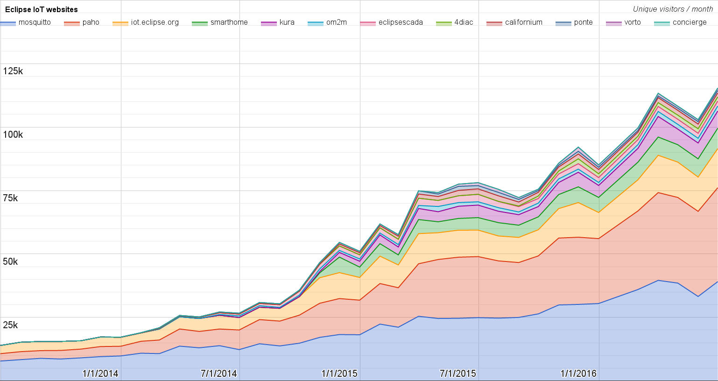
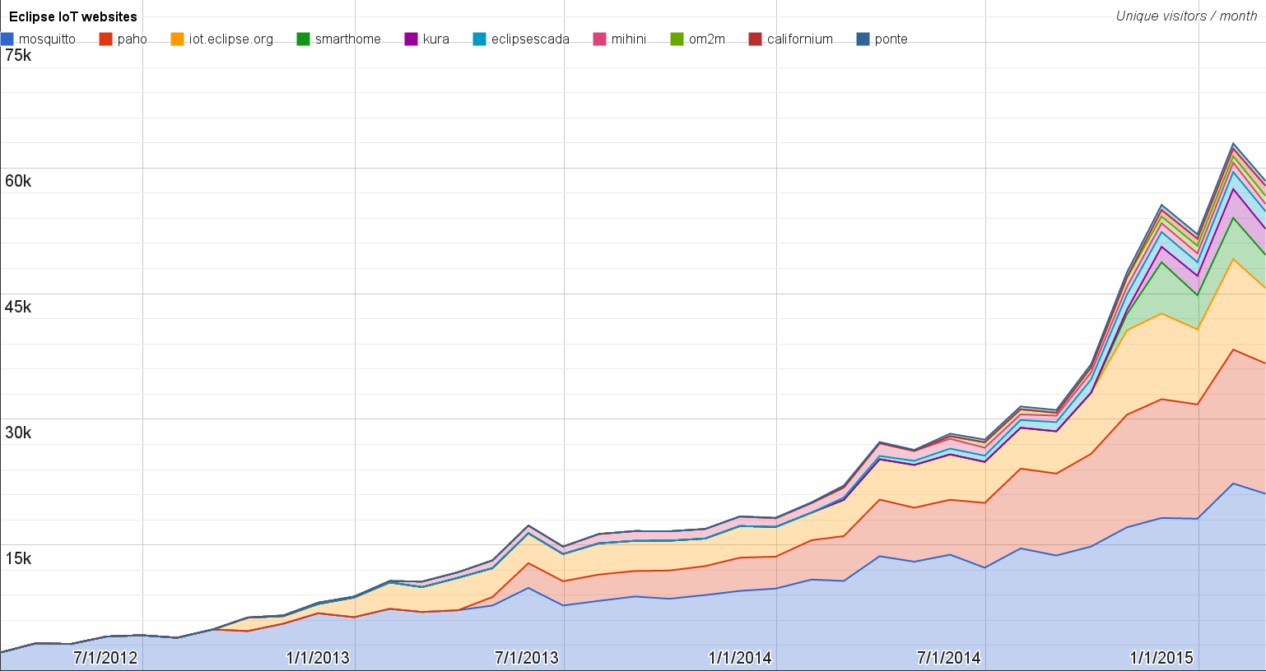
Websites
https://docs.google.com/spreadsheets/d/1MT8vUectDG7qnt83LBts-B7oECMsICXyB4Tn4Kxl64U/pubchart?oid=1293913369&format=image
Number of unique visitors this month | 115K
Month-over-month variation | +12%
Project with the highest growth this month | Eclipse Concierge (+224%)
Year-over-year variation | +74% (632K → 1.10M unique visitors)

Slide 5
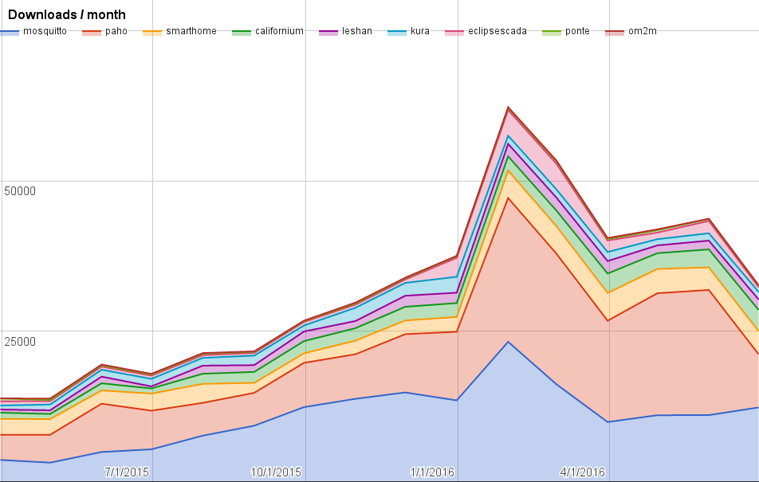
Downloads
https://docs.google.com/spreadsheets/d/1MT8vUectDG7qnt83LBts-B7oECMsICXyB4Tn4Kxl64U/pubchart?oid=1715994217&format=image
Downloads this month:
mosquitto | 12326
paho | 8846
smarthome | 3851
californium | 3511
leshan | 1747
kura | 1264
eclipsescada | 785
ponte | 249
om2m | 75

Slide 6
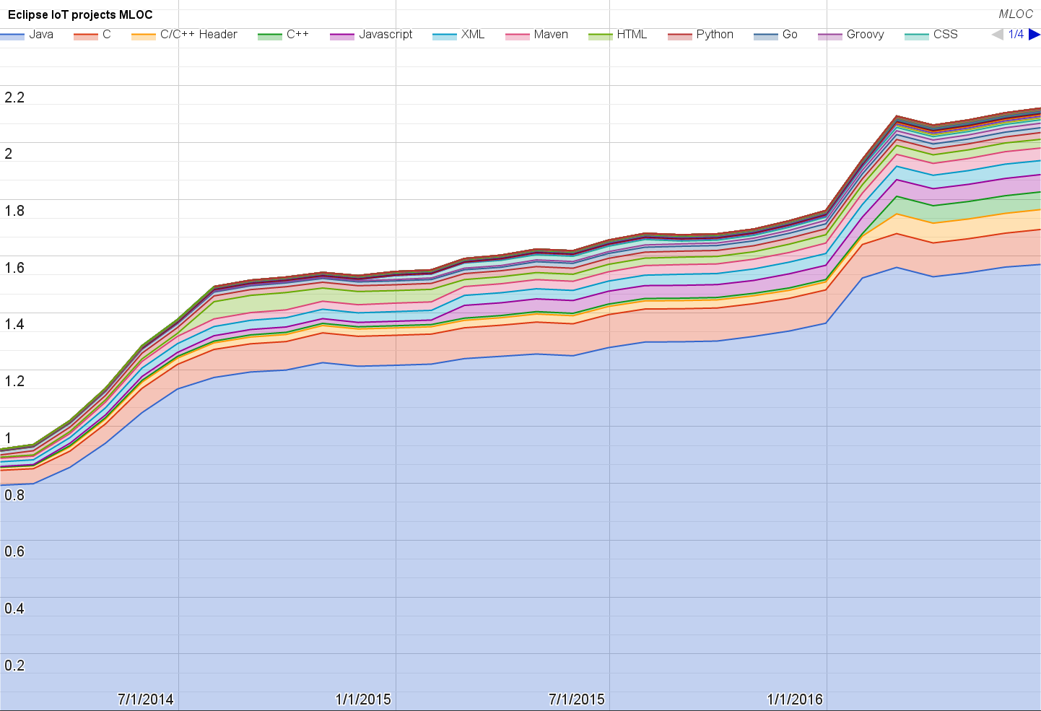
Lines of code (as of Jun-30, 2016)
https://docs.google.com/spreadsheets/d/1MT8vUectDG7qnt83LBts-B7oECMsICXyB4Tn4Kxl64U/pubchart?oid=1652481431&format=image

Slide 7
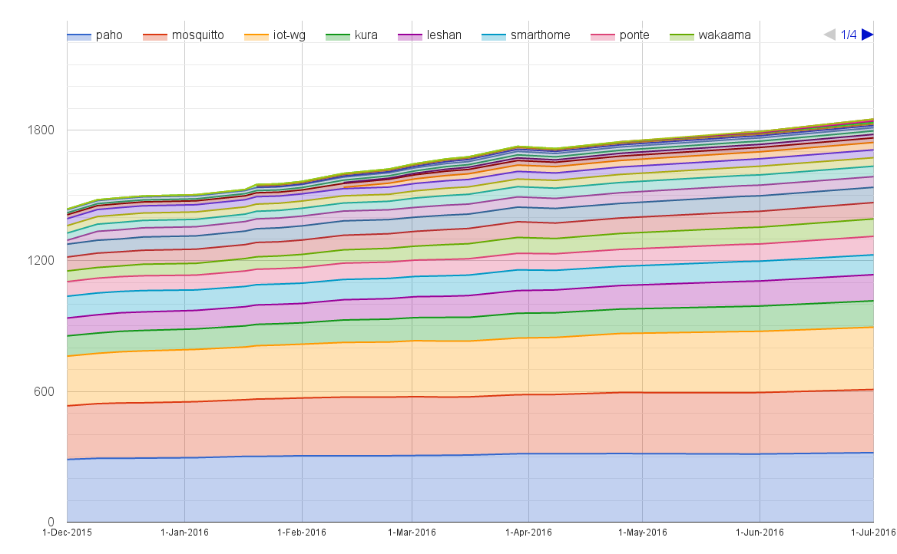
Mailing list subscriptions
https://docs.google.com/spreadsheets/d/1MT8vUectDG7qnt83LBts-B7oECMsICXyB4Tn4Kxl64U/pubchart?oid=1893372427&format=image

Slide 8
Sandbox servers (MQTT, CoAP, LwM2M)
MQTT (Mosquitto)
1322 active clients (+170% monthly)
CoAP
254 unique IP addresses (+28% monthly)
LWM2M
See Bug 467101

