Slide 1
Eclipse IoT monthly report
August 2017

Slide 2
Monthly projects development activity
AUG '17 | (color indicates variation compared to previous month)
 | Opened bugs | Closed bugs | Code authors | Commits | Posted messages | Senders
4diac | 26 | 29 | 6 | 62 | 10 | 5
californium | 4 | 2 | 8 | 74 | 35 | 8
concierge | 0 | 0 | 0 | 0 | 0 | 0
ditto | 0 | 0 | 0 | 0 | 0 | 0
eclipsescada | 4 | 0 | 0 | 0 | 0 | 0
edje | 0 | 0 | 0 | 0 | 0 | 0
hawkbit | 2 | 0 | 3 | 4 | 3 | 3
hono | 16 | 8 | 8 | 68 | 26 | 8
kapua | 13 | 9 | 6 | 229 | 40 | 6
krikkit | 0 | 0 | 0 | 0 | 0 | 0
kura | 58 | 82 | 6 | 44 | 8 | 3
leshan | 9 | 5 | 1 | 11 | 47 | 9
milo | 3 | 2 | 0 | 0 | 0 | 0
mosquitto | 46 | 12 | 2 | 8 | 20 | 12
om2m | 3 | 4 | 1 | 2 | 0 | 0
paho | 136 | 80 | 14 | 73 | 29 | 12
paho.incubator | 0 | 0 | 0 | 0 | 0 | 0
ponte | 0 | 0 | 0 | 0 | 1 | 1
risev2g | 0 | 0 | 0 | 0 | 0 | 0
smarthome | 85 | 93 | 17 | 150 | 9 | 3
tinydtls | 0 | 0 | 0 | 0 | 3 | 2
unide | 4 | 0 | 1 | 8 | 0 | 0
vorto | 42 | 64 | 6 | 46 | 0 | 0
wakaama | 0 | 3 | 1 | 3 | 14 | 8
whiskers | 0 | 0 | 0 | 0 | 0 | 0
ALL PROJECTS | 451 | 393 | 80 | 782 | 245 | 80

Slide 3
Yearly projects development activity
SEP '16 - AUG '17 | (color indicates variation compared to previous period)
 | Opened bugs | Closed bugs | Code authors | Commits | Posted messages | Senders
4diac | 204 | 206 | 10 | 346 | 13 | 5
californium | 126 | 111 | 22 | 789 | 525 | 39
concierge | 24 | 3 | 5 | 15 | 8 | 6
ditto | 0 | 0 | 1 | 1 | 0 | 0
eclipsescada | 8 | 4 | 3 | 310 | 9 | 2
edje | 1 | 1 | 2 | 70 | 8 | 5
hawkbit | 49 | 47 | 13 | 400 | 14 | 9
hono | 131 | 116 | 13 | 806 | 302 | 41
kapua | 357 | 236 | 16 | 3824 | 456 | 21
krikkit | 0 | 0 | 0 | 0 | 1 | 1
kura | 557 | 533 | 21 | 1478 | 398 | 40
leshan | 84 | 69 | 20 | 361 | 342 | 64
milo | 49 | 47 | 6 | 208 | 115 | 24
mosquitto | 219 | 127 | 30 | 174 | 344 | 127
om2m | 97 | 130 | 5 | 65 | 13 | 12
paho | 661 | 496 | 66 | 966 | 463 | 217
paho.incubator | 0 | 0 | 0 | 0 | 0 | 0
ponte | 22 | 5 | 2 | 3 | 5 | 5
risev2g | 4 | 4 | 1 | 14 | 0 | 0
smarthome | 837 | 744 | 92 | 1181 | 49 | 9
tinydtls | 21 | 21 | 3 | 37 | 93 | 18
unide | 10 | 4 | 2 | 22 | 8 | 5
vorto | 208 | 199 | 8 | 403 | 12 | 9
wakaama | 60 | 49 | 13 | 136 | 116 | 53
whiskers | 2 | 0 | 2 | 21 | 11 | 8
ALL PROJECTS | 3731 | 3152 | 297 | 11630 | 3305 | 411

Slide 4
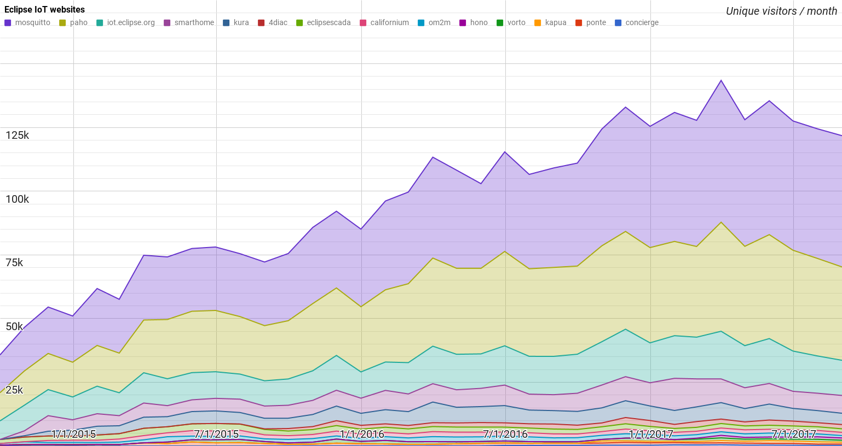
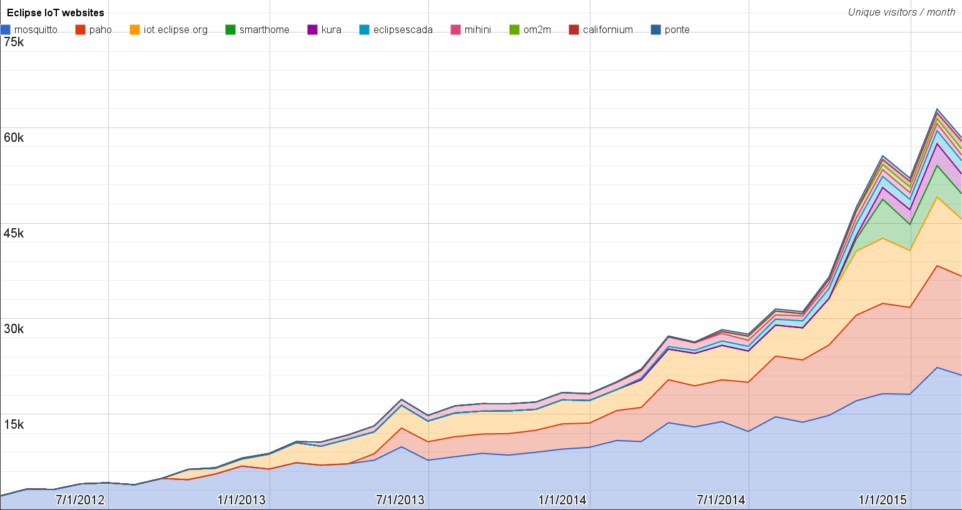
Websites
https://docs.google.com/spreadsheets/d/1MT8vUectDG7qnt83LBts-B7oECMsICXyB4Tn4Kxl64U/pubchart?oid=1293913369&format=image
Number of unique visitors this month | 121.7K
Month-over-month variation | -2%
Project with the highest growth this month | Eclipse 4diac (+6%)
Year-over-year variation | +29% (1.19K → 1.53M visitors)

Slide 5
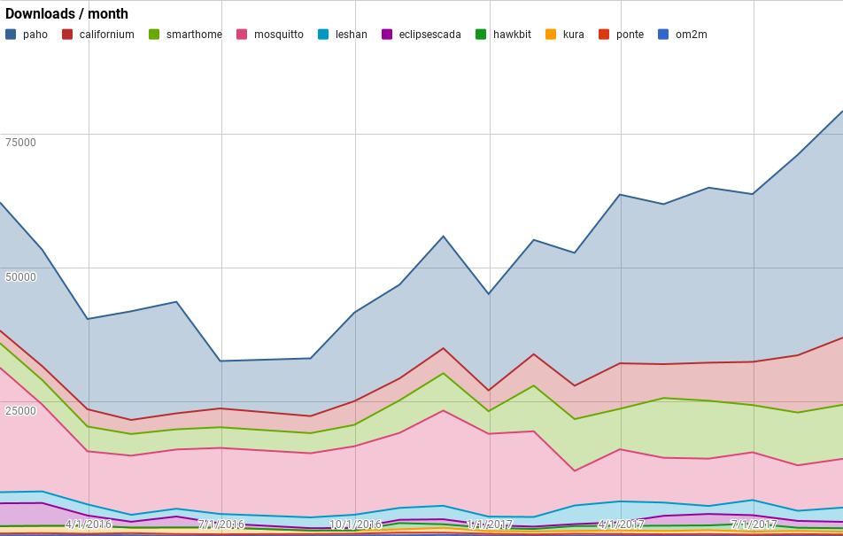
Downloads
https://docs.google.com/spreadsheets/d/1MT8vUectDG7qnt83LBts-B7oECMsICXyB4Tn4Kxl64U/pubchart?oid=1715994217&format=image
Downloads this month:
paho | 42311
californium | 12518
smarthome | 10078
mosquitto | 9097
leshan | 2666
eclipsescada | 1188
hawkbit | 630
kura | 542
ponte | 214
om2m | 76
Grand Total | 79320

Slide 6
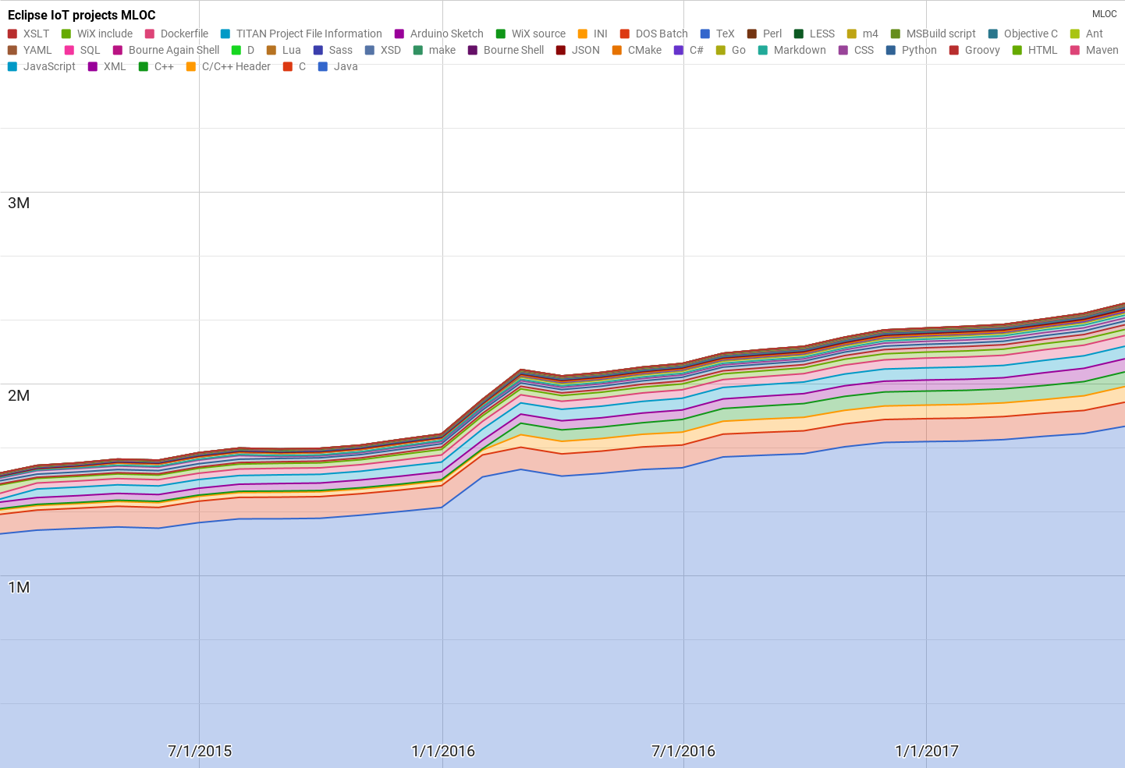
Lines of code (as of May-31, 2017)
https://docs.google.com/spreadsheets/d/1MT8vUectDG7qnt83LBts-B7oECMsICXyB4Tn4Kxl64U/pubchart?oid=1652481431&format=image

Slide 7
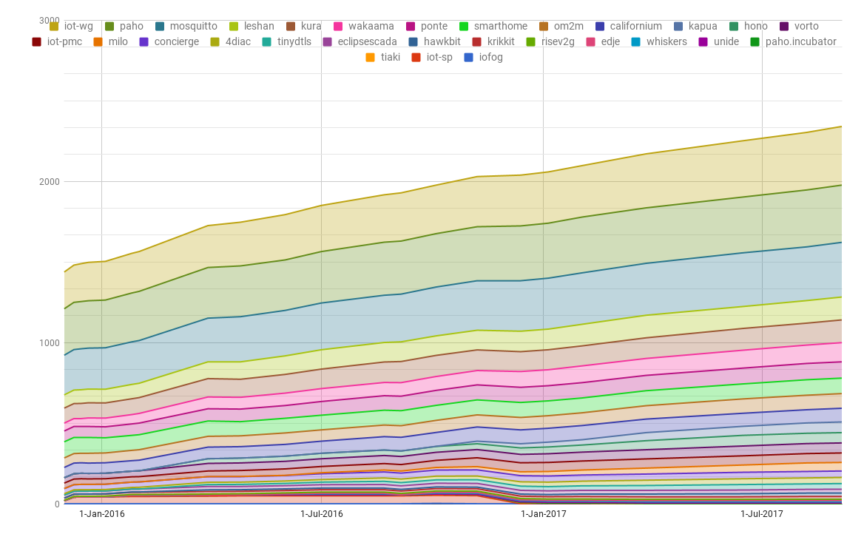
Mailing list subscriptions
https://docs.google.com/spreadsheets/d/1MT8vUectDG7qnt83LBts-B7oECMsICXyB4Tn4Kxl64U/pubchart?oid=1893372427&format=image

