Slide 1
Scrum EPF Practice
draft

Slide 2
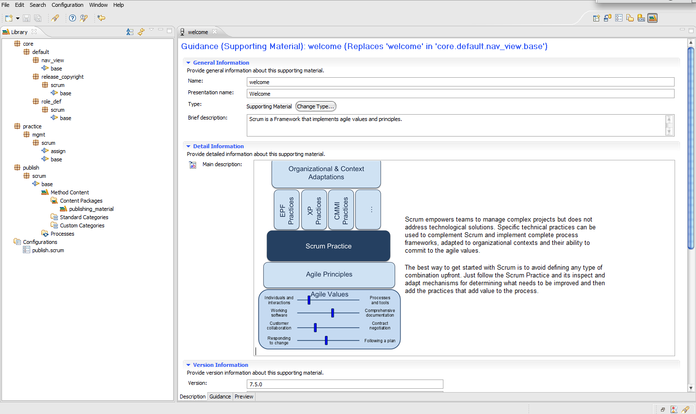
Library Structure

Slide 3
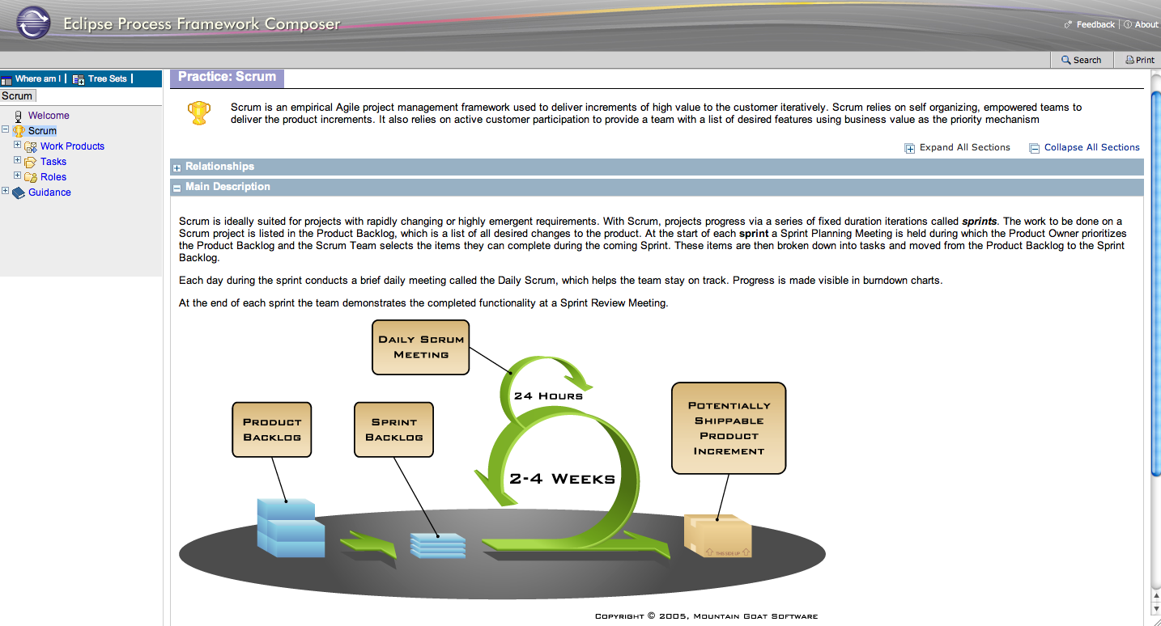
Publishing View

