Slide 1
Che Knowledge Transfer - Factories
Factory acceptance process

Slide 2
Factory acceptance process
Che Knowledge Transfer - Factory acceptance process
Factory acceptance process in Che consists of 2 main steps: - Parsing of incoming parameters and create Factory object from them;
- Accept factory object and create a workspace;
Typically, those two steps are initiated subsequently by Che Dashboard.
This presentation will cover those processes in technical details from Che server point of view.

Slide 3
Step 1: Parsing of incoming parameters and create Factory object from them
Che Knowledge Transfer - Factory acceptance process
Factory first step is accepting factory parameters, validating them and creating Factory object. This process starts from api/factory/resolver REST API endpoint. This endpoint accepts all parameters, ant tries to find correct resolver which can process them. After matching resolver is found, it parses remote repository URL into object, prepares FileContentProvider instance (most of them are smart enough to make authenticated requests for private repositories, etc). If no specific provider is found, a default one is used assuming given URL points directly to devfile contents.
After that, URLfactoryBuilder tries to find a devfile and related files (for v2) in the repository, or, if there is none, composes default one. Also it performs schema and integrity validations while parsing devfile content, and then builds the factory object containing devfile.
More detailed diagram of the processing factory request is shown below.

Slide 4
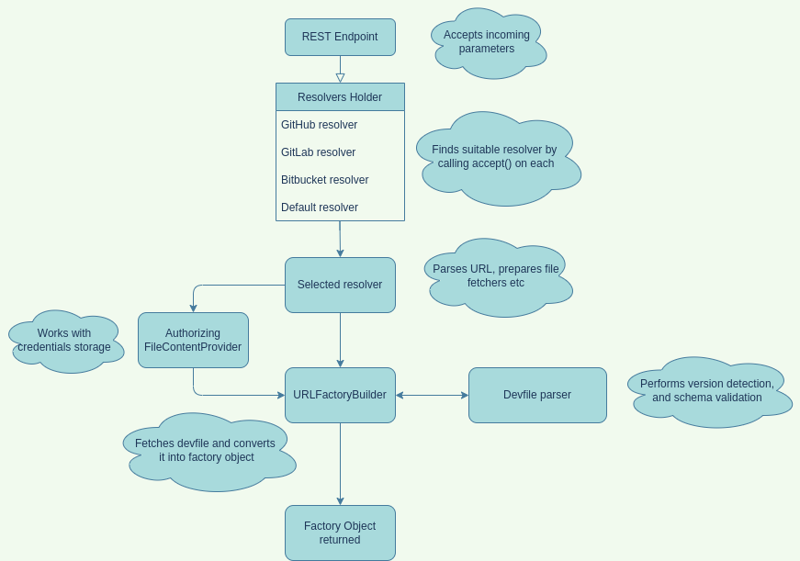
Step 1: Parsing of incoming parameters and create Factory object
Che Knowledge Transfer - Factory acceptance process

Slide 5
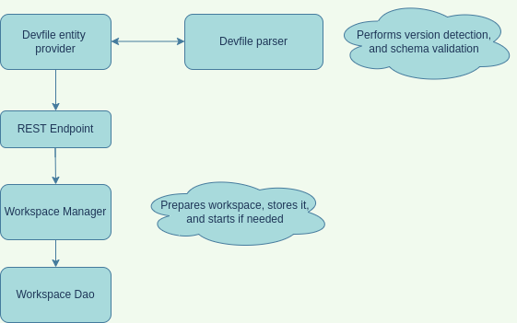
Step 2: Accept factory object and create a workspace from Devfile v.1
Che Knowledge Transfer - Factory acceptance process
After Factory object is produced on step 1, user workspace can be created any time later from it by extracting the devfile field and send it to the appropriate REST endpoint. The workspace creation is responsibility of the api/workspace/devfile endpoint. It accepts only v1 version devfiles. It passes Devfile object to the Workspace manager, which performs its internal structure and integrity validations, selects correct namespace and the creates the actual workspace.

Slide 6
Step 2: Accept factory object and create a workspace from Devfile v.2
Che Knowledge Transfer - Factory acceptance process
Devfiles of v.2 are processed directly by Che operator, so there is no actions from Che server side.

Slide 7
Devfile validation by JSON schemas
Che Knowledge Transfer - Factory acceptance process
Validations of Devfile compliance is based on JSON schema validation mechanism, and class which responsible for
that is DevfileSchemaValidator. As the devfile format growing and expanding, there is a few versions of it, as well as respective devfile scheme versions: 1.0.0, 2.0.0, 2.1.0, 2.2.0. Those schemas are located in the /resources
folder of the che-core-api-workspace module.
All those schemas are loaded into memory as a map with version as a key, so when devfile arrives to validation, it’s version must match one of the supported versions. Then specific schema is loaded, and devfile is being validated with the help of Justify library, using its JsonValidationService
If any error(s) occur, they’re collected to the set and returned as the DevfileFormatException

Slide 8
Factory-related configuration properties of Che server
Che Knowledge Transfer - Factory acceptance process
CHE_FACTORY_DEFAULT__PLUGIN : List of plugins that will be used for factories that are created from a remote Git repository which does not contain any devfile
CHE_FACTORY_DEFAULT__DEVFILE__FILENAMES : Devfile filenames to look on the remote repository.
Che will try to locate those files in the order they enumerated in the property.
CHE_FACTORY_DEFAULT__EDITOR : Editor that will be used for factories that are created from a remote Git repository
which does not contain any devfile
CHE_FACTORY_SCM__FILE__FETCHER__LIMIT__BYTES : Max file size in bytes for fetching factory-related files
CHE_FACTORY_DEVFILE2__FILES__RESOLUTION__LIST : Additional files which may be present in repository to
complement devfile v2

Slide 9
The end
Author: Max Shaposhnyk (mshaposh@redhat.com)

